Slide 1







Situational Leadership Theory
Muhammad Afaq 2021-SE-18
Abdul Haseeb 2021-SE-22
Saad Amjad 2021-SE-32
Wali Muhammad 2021-SE-39
Faqeed Hasan 2021-SE-54

Slide 2
Content
Definition
Leadership Styles
Follower Maturity Level
Contextual Elements
Pros & Cons

Slide 3
Definition
Developed by ‘Paul Hersey’ and ‘Ken Blanchard’ in the 1970s.
Focuses on adapting leadership styles based on the "readiness" or competence of followers.

Slide 4


Importance
Helps leader be flexible and effective in diverse situation.
Emphasizes that there is no "one-size-fits-all" leadership style.

Slide 5
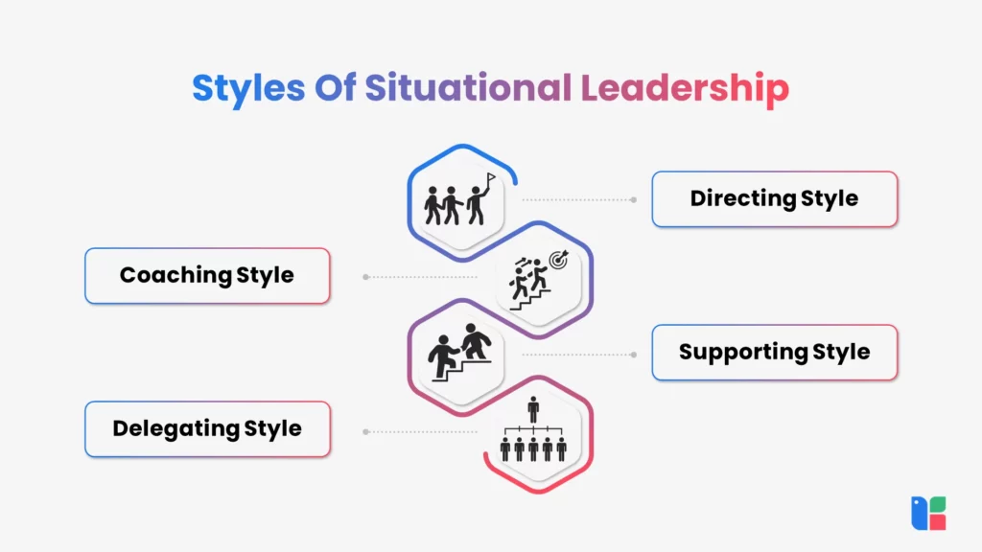
Leadership Style
Directing
Coaching
Delegating
Supporting
(Telling)
High control,
step-by-step guidance
(Selling) Motivational, encourages participation
Shares decision-making
(Participating)
Gives full responsibility to the team

Slide 7
Follower Readiness
The ability and willingness of followers to accomplish a specific task.
R1
Unable and unwilling (insecure).
R2
Unable but willing (motivated).
R3
Able and unwilling (hesitant).
R4
Able and willing (confident).

Slide 8
Readiness Breakdown
R
Low Readiness
Followers lack both the ability and willingness to complete a task, requiring a highly directive "telling" leadership style
1
2
3
4
Moderate Readiness
Followers are willing to do the task but lack the necessary skills, so a "selling" leadership style is best.
Moderate to High Readiness
Followers have the skills but may lack confidence or motivation, requiring a "participating" leadership.
High Readiness
Followers are both able and willing to complete the task independently, allowing for a "delegating" leadership.

Slide 9
Low Readiness
Followers lack both the ability and willingness to complete a task, requiring a highly directive "telling" leadership style
1
2
3
4
Readiness Breakdown
R
Moderate Readiness
Followers are willing to do the task but lack the necessary skills, so a "selling" leadership style is best.
Moderate to High Readiness
Followers have the skills but may lack confidence or motivation, requiring a "participating" leadership.
High Readiness
Followers are both able and willing to complete the task independently, allowing for a "delegating" leadership.

Slide 10
Low Readiness
Followers lack both the ability and willingness to complete a task, requiring a highly directive "telling" leadership style
1
2
3
4
Moderate Readiness
Followers are willing to do the task but lack the necessary skills, so a "selling" leadership style is best.
Readiness Breakdown
R
Moderate to High Readiness
Followers have the skills but may lack confidence or motivation, requiring a "participating" leadership.
High Readiness
Followers are both able and willing to complete the task independently, allowing for a "delegating" leadership.

Slide 11
Low Readiness
Followers lack both the ability and willingness to complete a task, requiring a highly directive "telling" leadership style
1
2
3
4
Moderate Readiness
Followers are willing to do the task but lack the necessary skills, so a "selling" leadership style is best.
Moderate to High Readiness
Followers have the skills but may lack confidence or motivation, requiring a "participating" leadership.
Readiness Breakdown
R
High Readiness
Followers are both able and willing to complete the task independently, allowing for a "delegating" leadership.

Slide 12
Elements
The main point of Situational Leadership is that none of these styles is best.
Four key contextual factors for leader

Slide 13
Elements
E
Consider the Relationship
Leaders must evaluate the social and interpersonal dynamics between themselves and group members to choose the most effective leadership style.
1
2
3
4
Consider the Task
Leaders need to clearly understand the complexity and requirements of the task to determine if it has been successfully accomplished.
Consider the Level of Authority
Leaders should assess their formal and informal power over the group, whether derived from their position or through respect and relationships.
Consider the Level of Maturity
Leaders must evaluate each member’s ability and willingness to complete the task to assign roles and leadership styles effectively.

Slide 14
Consider the Relationship
Leaders must evaluate the social and interpersonal dynamics between themselves and group members to choose the most effective leadership style.
1
2
3
4
Elements
E
Consider the Task
Leaders need to clearly understand the complexity and requirements of the task to determine if it has been successfully accomplished.
Consider the Level of Authority
Leaders should assess their formal and informal power over the group, whether derived from their position or through respect and relationships.
Consider the Level of Maturity
Leaders must evaluate each member’s ability and willingness to complete the task to assign roles and leadership styles effectively.

Slide 15
Consider the Relationship
Leaders must evaluate the social and interpersonal dynamics between themselves and group members to choose the most effective leadership style.
1
2
3
4
Consider the Task
Leaders need to clearly understand the complexity and requirements of the task to determine if it has been successfully accomplished.
Elements
E
Consider the Level of Authority
Leaders should assess their formal and informal power over the group, whether derived from their position or through respect and relationships.
Consider the Level of Maturity
Leaders must evaluate each member’s ability and willingness to complete the task to assign roles and leadership styles effectively.

Slide 16
Consider the Relationship
Leaders must evaluate the social and interpersonal dynamics between themselves and group members to choose the most effective leadership style.
1
2
3
4
Consider the Task
Leaders need to clearly understand the complexity and requirements of the task to determine if it has been successfully accomplished.
Consider the Level of Authority
Leaders should assess their formal and informal power over the group, whether derived from their position or through respect and relationships.
Elements
E
Consider the Level of Maturity
Leaders must evaluate each member’s ability and willingness to complete the task to assign roles and leadership styles effectively.

Slide 17


Pros & Cons
Advantages of SLT
Flexibility: Leaders can adapt to different situations.
Improved follower performance: Tailored support boosts productivity.
Enhanced communication: Leaders understand followers' needs better.
Limitations of SLT
Requires leaders to accurately assess follower readiness.
May be challenging to implement in large organizations.

Slide 18
"Effective leadership is not about being rigid but about being responsive to the needs of team."

Slide 19
Thank You

